Slide 1
Solar Power Production Forecasting - Modelling
Liam Håkansson, Joakim Lind Hasselskog, Jacob Genander, Luis Nieto Piña, Vishnu Sharma, Johan Gustafsson, Johan Ebenhard, Anders Åhlen,

Slide 2
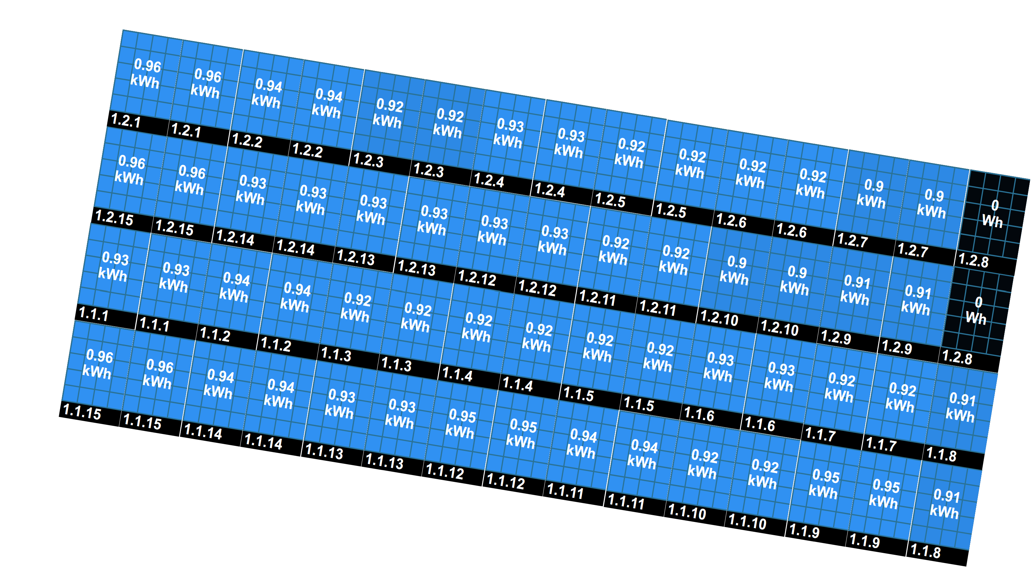
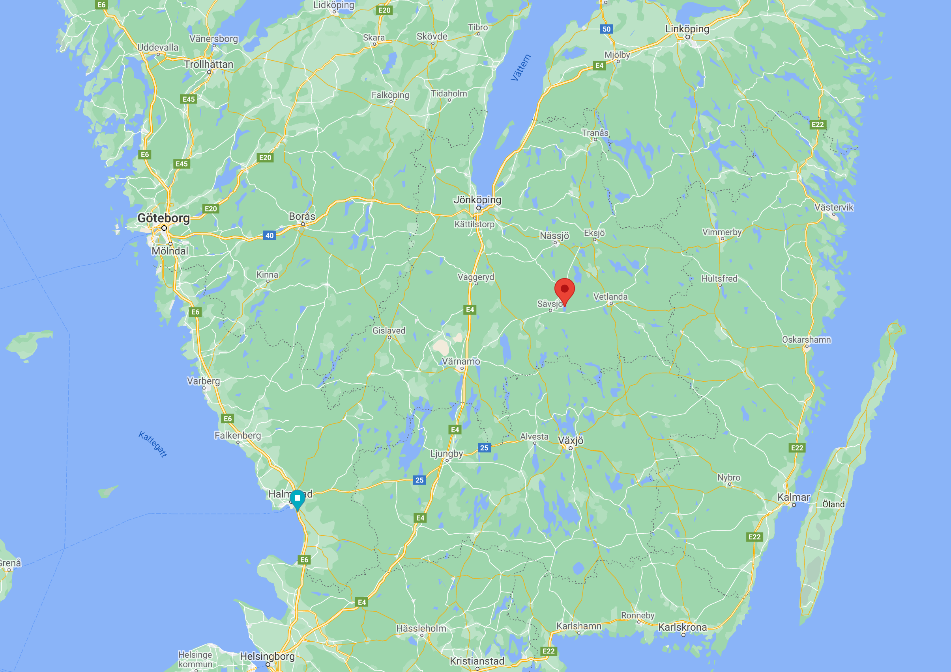
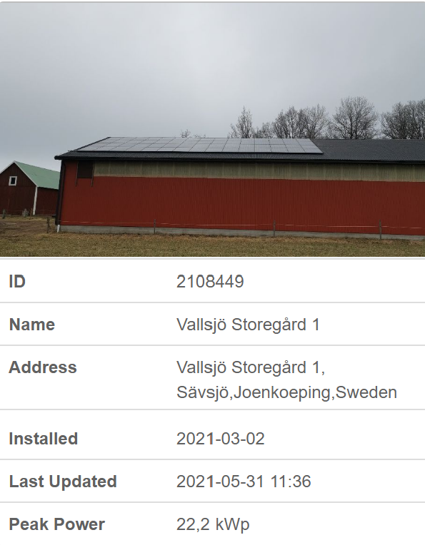
Solar power production

Slide 3
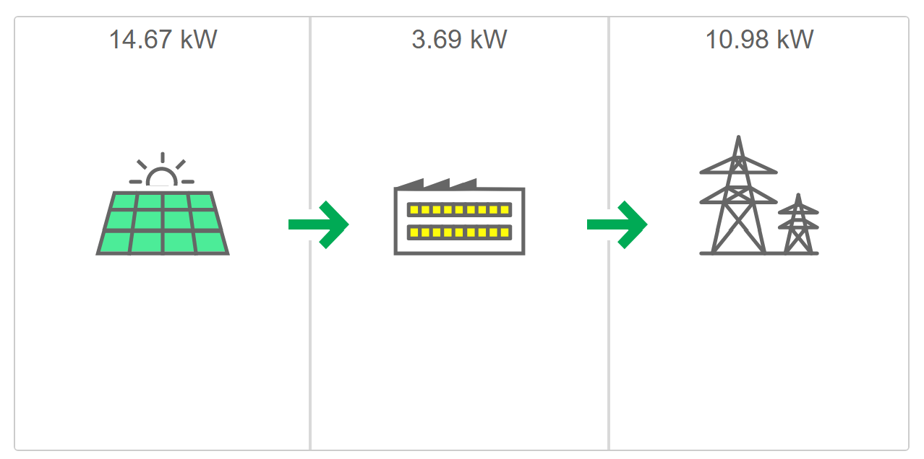
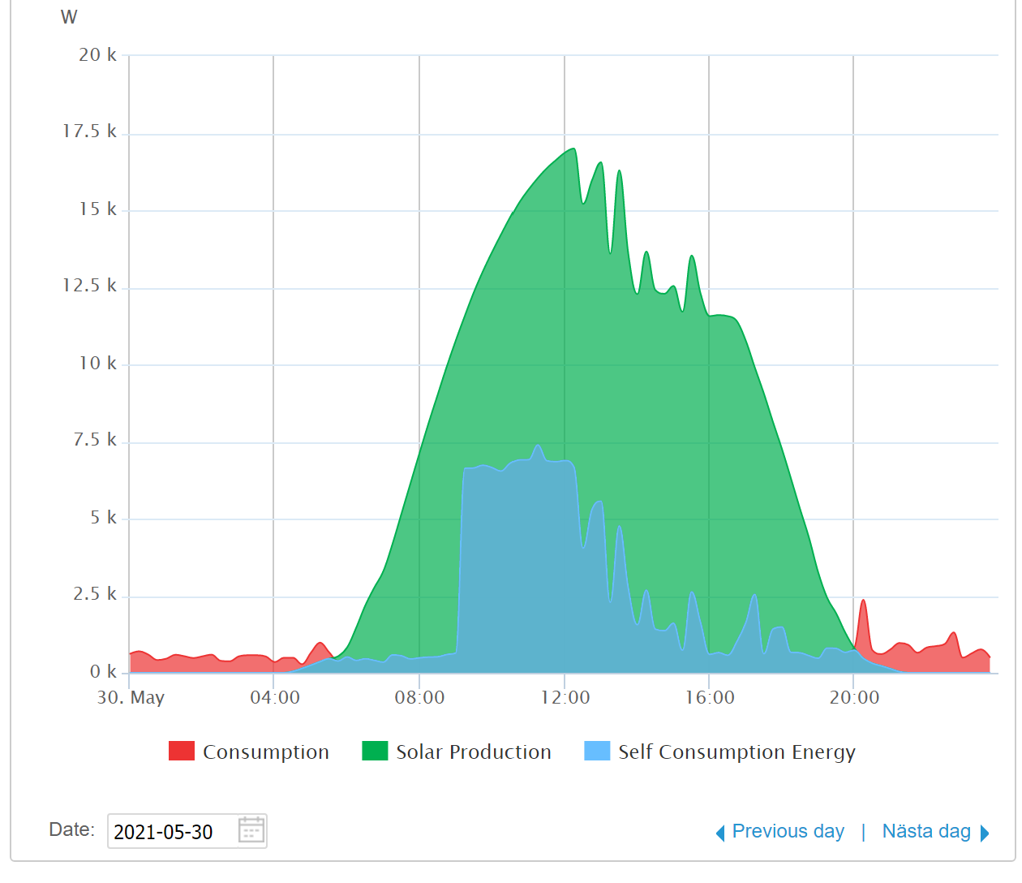


Solar power production
Selling
electricity
Production Limit
22.2kW
Export Limit
11kW
Buying
electricity

Slide 4
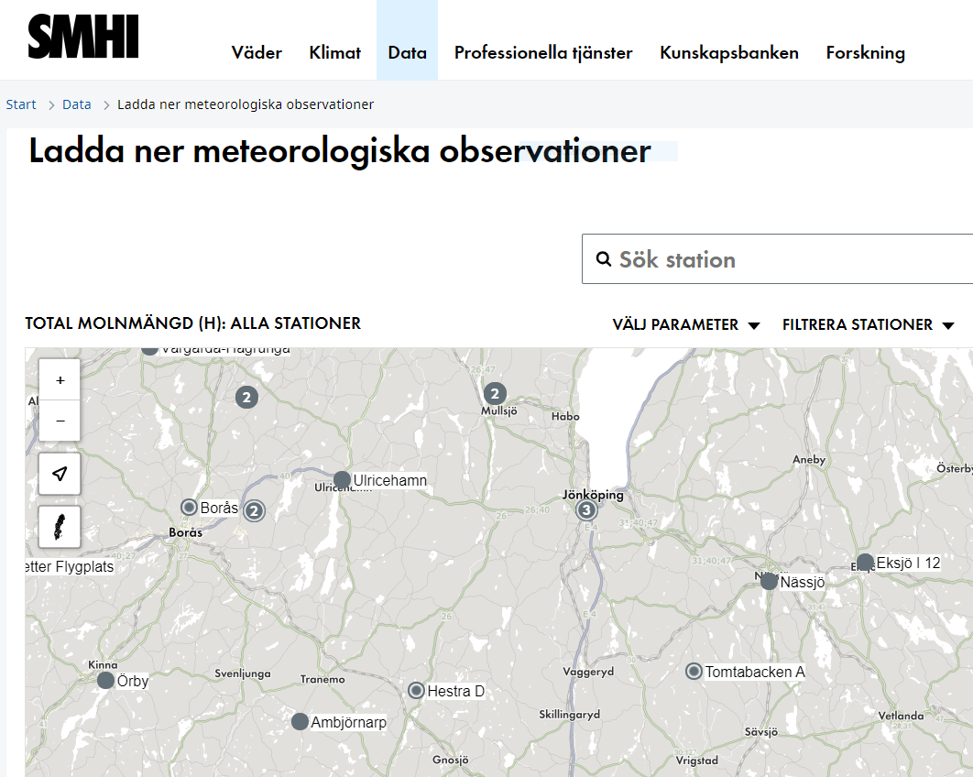
Data sources
Predictors: SMHI weather observations (visibility, cloud cover, precipitation)
Limited number of predictors and time span -> acquiring more data would probably improve model

Slide 5
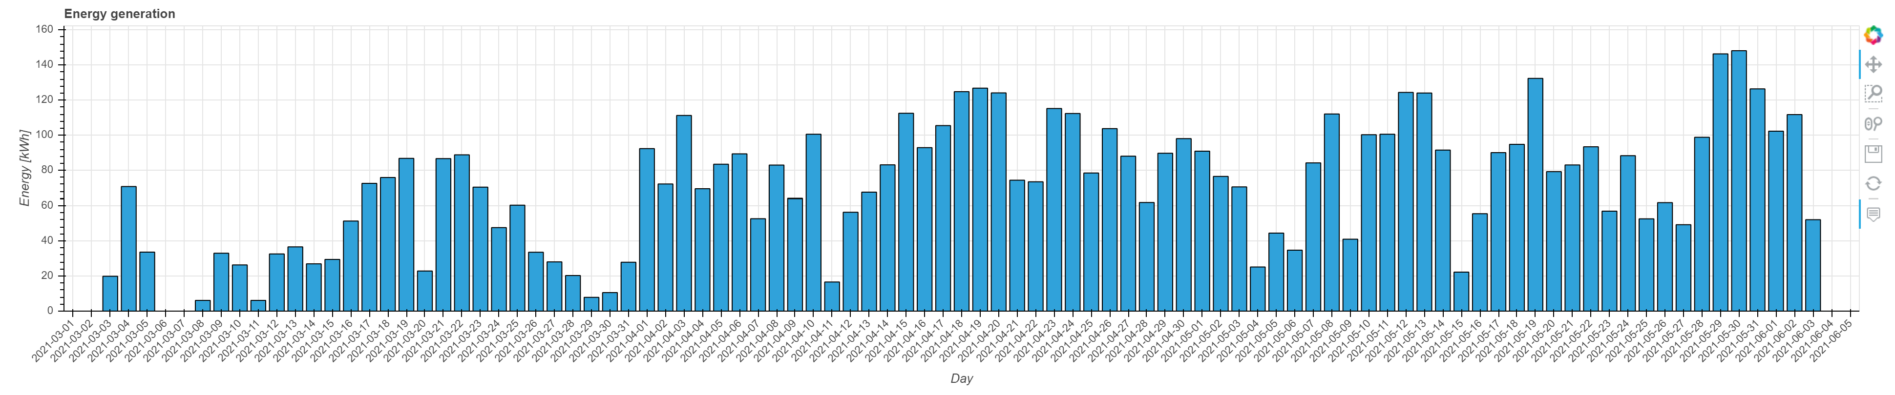
TARGET: Total Energy Production Per Day [kWh]
Train data
Test data

Slide 6
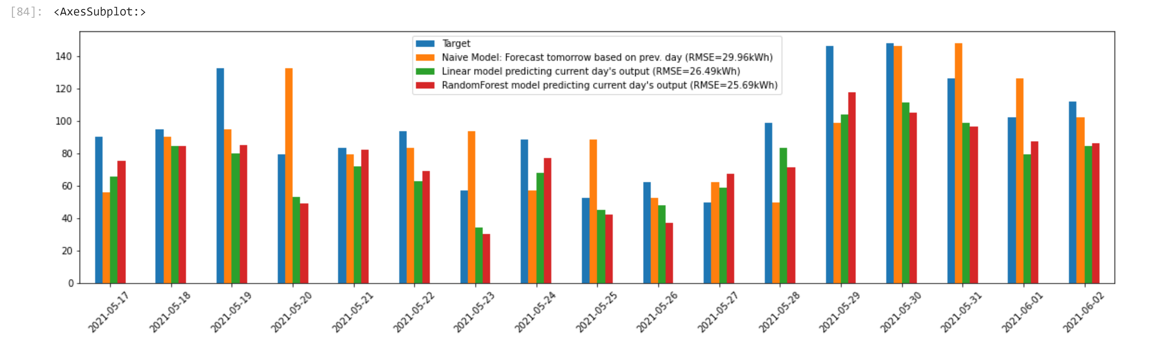
RESULT: Predictions on the test set

Slide 7
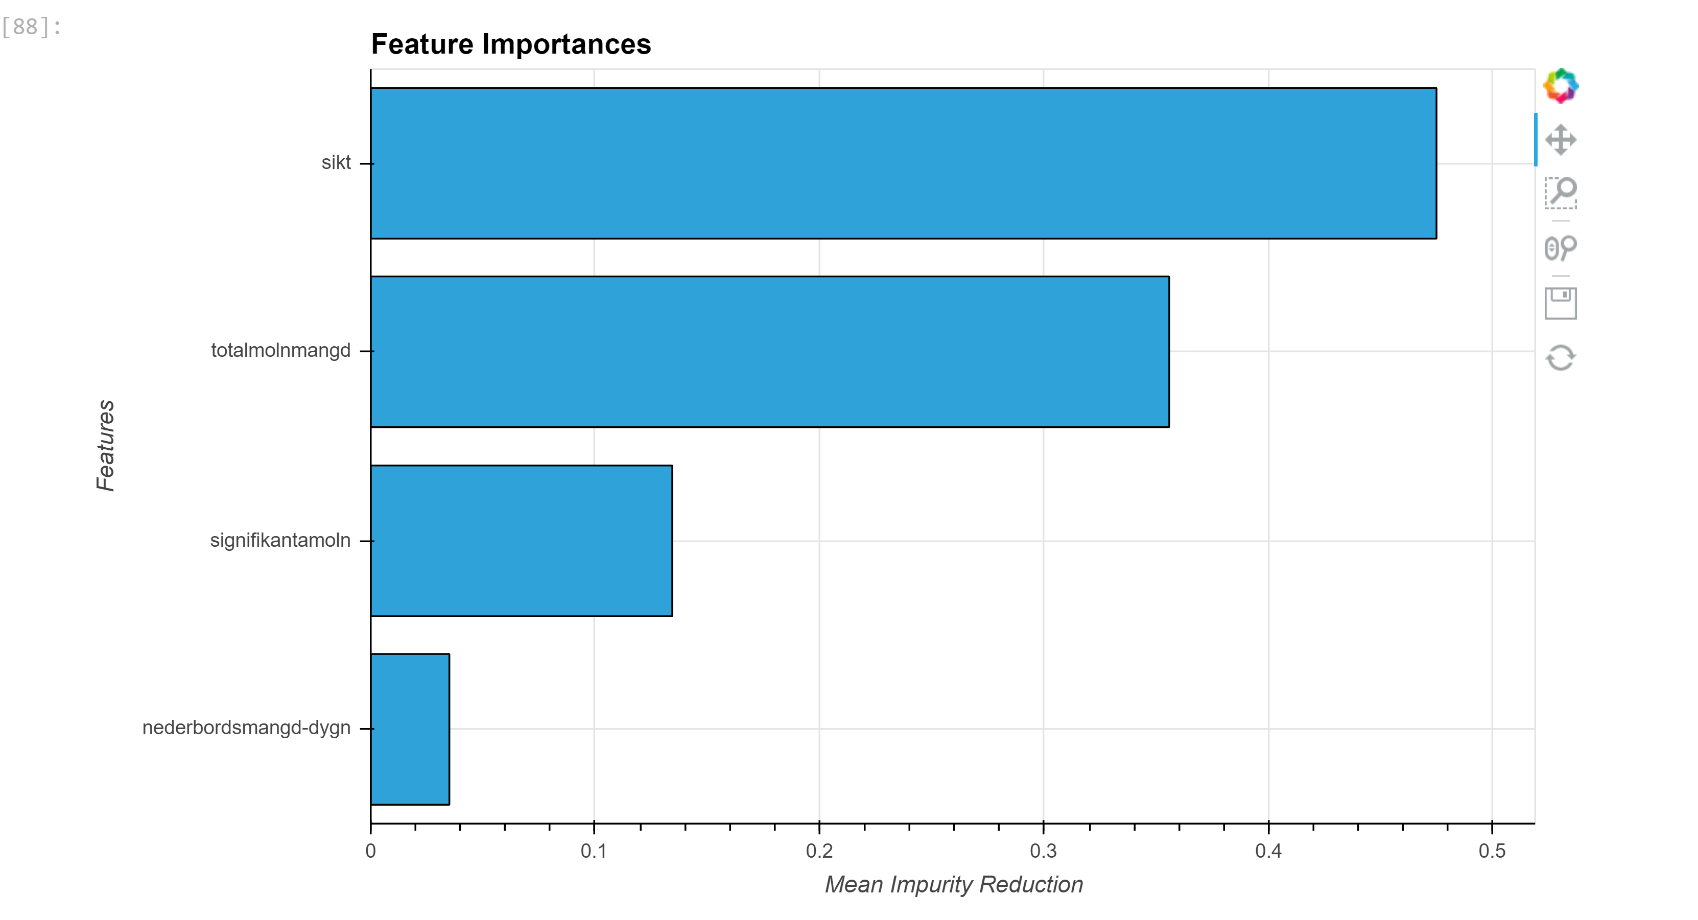
Which SMHI data predictors were most useful?
Visibility
Total cloud
“Significant cloud”
Precipitation

Slide 9
Solar Power Production Forecasting
Liam Håkansson, Joakim Lind Hasselskog, Jacob Genander, Luis Nieto Piña, Vishnu Sharma, Johan Gustafsson, Johan Ebenhard, Anders Åhlen,

Slide 10
Vision and Application Ideas
Vision
Enabling prosumers and energy companies to optimize production and consumption based on visibility powered by predictions
Local Prosumer Digital Twin application
Represents the local consumption and production system
Visibility of current and predicted system state
Providing recommendations based on predictions, e.g.: ”When to charge the car”
Supports Intent Based Management ¹⁾
Comprises data, control facilities and prediction capabilities
Environmentally aware energy prosumer community social media application
Channel/app showing production and consumption for local prosumers
Visualizing the aggregate effect of collective prosumer actions
Making environmental consequences of decisions explicit to the users
Potentially utilizing the Digital Twin application
1) Managing a system by stating goals that the system fulfills autonomously

Slide 11
